Slide 1
Predicting Liquidity Pool Yields using Catboost, XGBoost, and Random Forest
Chris Buren and Yinan Chen

Slide 2
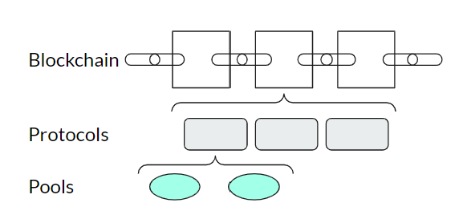
Project & Data
Goal: use several machine-learning models to predict the fair yield APYs on liquidity pools on public blockchains
Utilize 33 risk factors (features) related to the pools, such as its method of generating yield, TVL, IL, the chain and project it is built upon, historical changes in yield, and others.
Data from DefiLlama, one of the top providers of Defi data
Application: predicting fair yield APY of a pool. If actual yield differs greatly from predicted yield, market mispriced risk leaving potential for trading/staking activities.

Slide 3
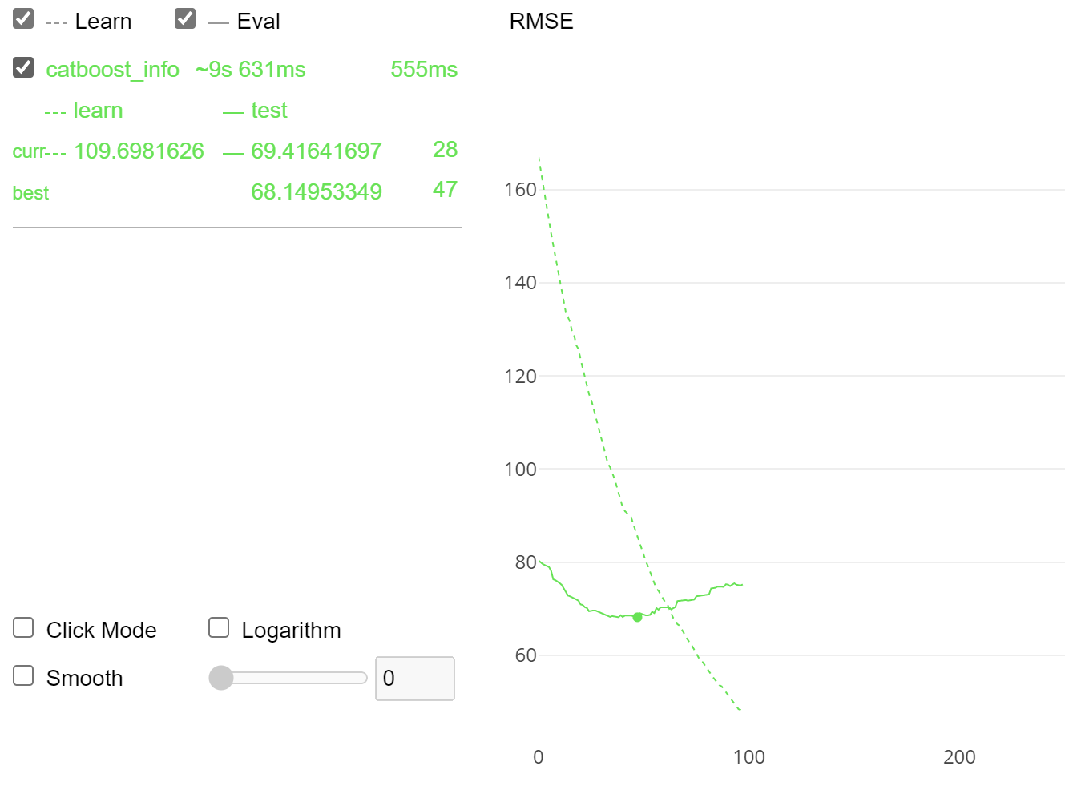
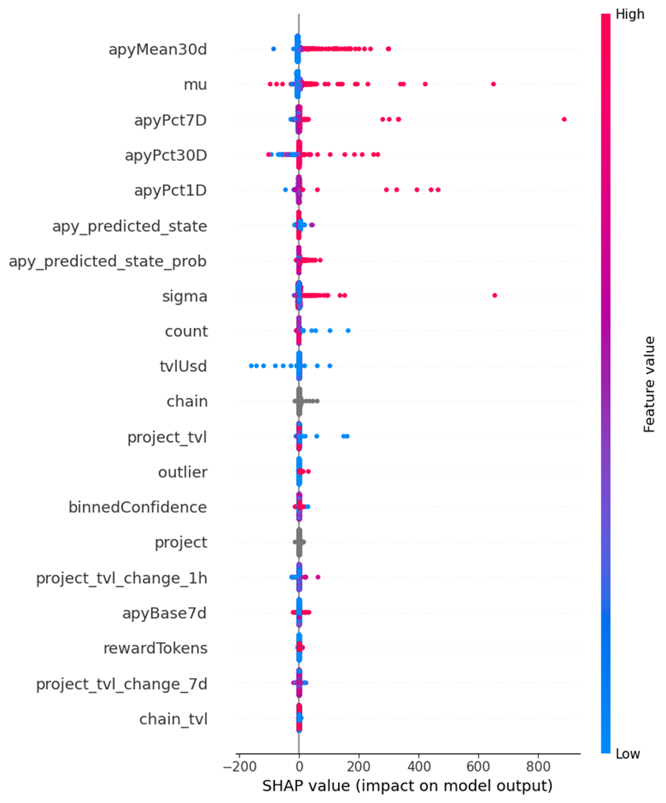
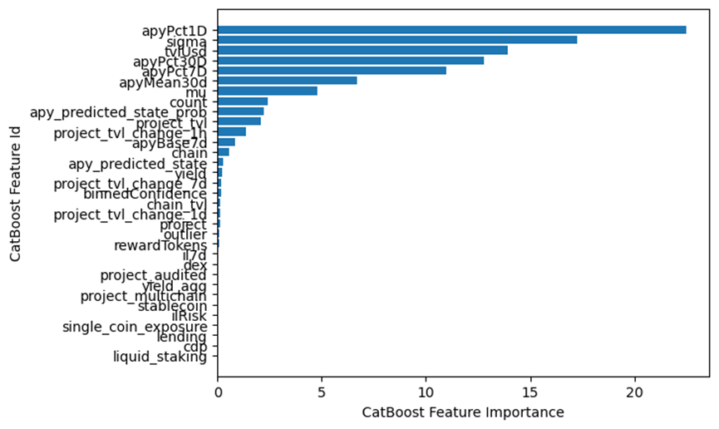
Catboost

Slide 4
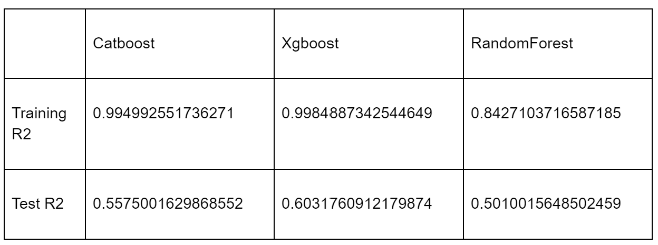
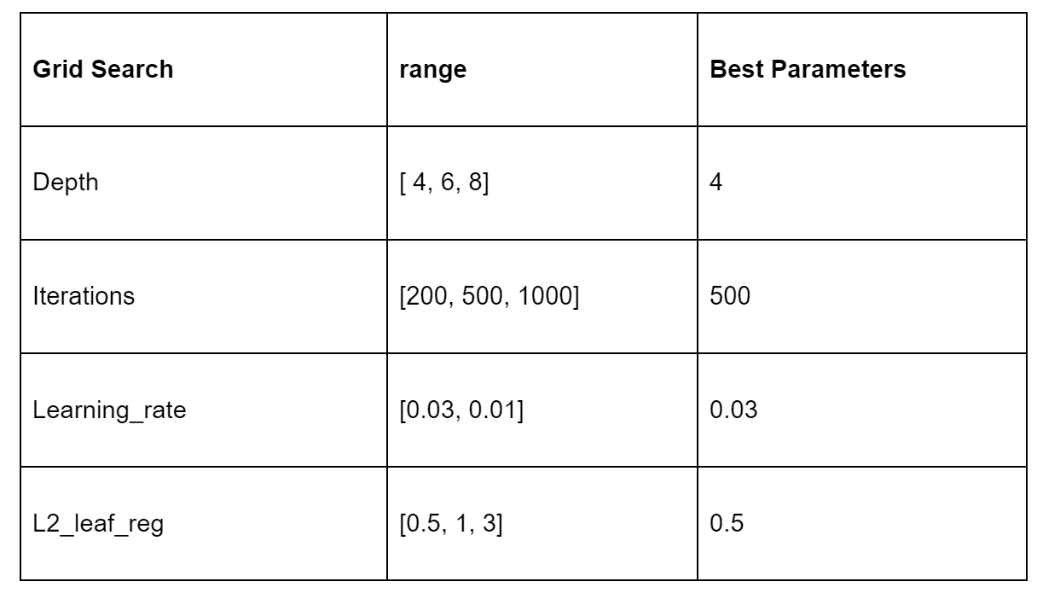
XGBoost & Random Forest

